Slide 1
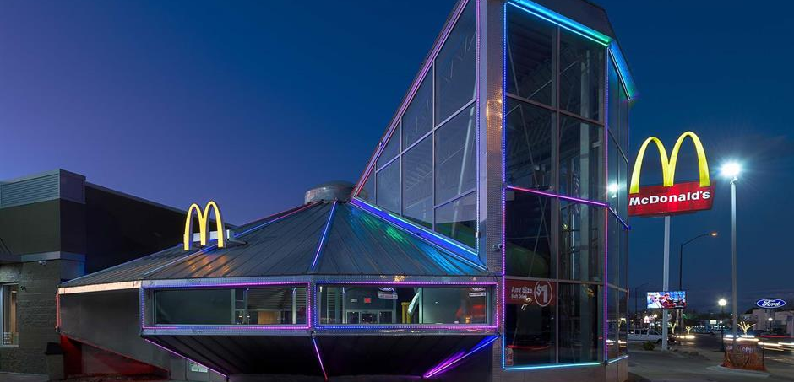
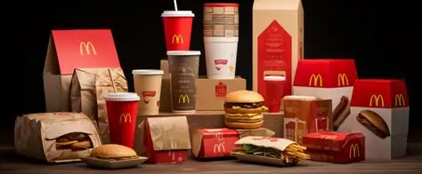
McDonald’s Sales Analysis
Milestone Project
Presented by: Shivani Awasthi

Slide 2
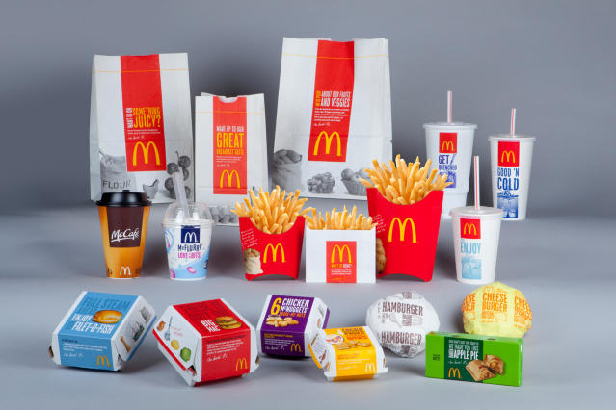
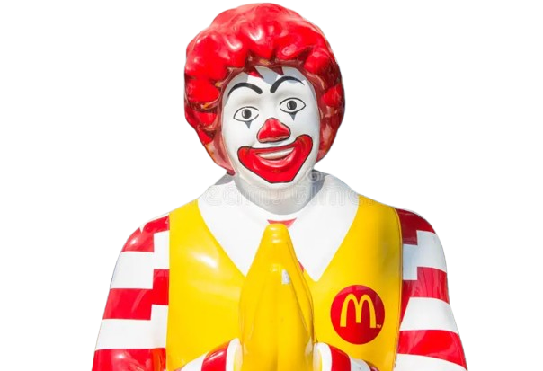
Table of Contents
Objective
Executive Summary
Dashboard
Key Findings
Insights & Suggestions

Slide 3

Objective
Create an interactive and dynamic dashboard in Excel using the McDonald's sales dataset to analyze various aspects of sales performance, item popularity, customer preferences, and time-based trends. The dashboard should provide actionable insights and allow for easy data exploration.
Targeted Area:
What is the total sales revenue for each category of menu items?
How many orders are placed each day?
Which menu item is the most frequently ordered?
What is the total revenue generated by menu items?
How does the revenue of each category compare over months?
What is the average number of items per order?
How do order volumes vary by time of day?
How do sales trends differ across weekdays and weekends?
Compare the sales of top 5 menu items.

Slide 4
Executive Summary
Our sales dashboard gives a clear picture of how customers are ordering, which items are the most popular and how revenue is spread out over time and across different product categories.
Between January and March 2023, we received a total of 5,370 orders. On average, each order included about 2.3 items. The Side Salad was the top-selling item during this time, standing out as a customer favorite.
Most of the revenue comes from burgers, followed by chicken dishes and salads, with fries and shakes also making a solid contribution.
Order volume tends to peak around lunchtime (12 PM–2 PM) and again in the early evening (5 PM–7 PM). Weekdays are especially busy, with about 160% more dishes ordered compared to weekends.
This analysis helps us identify the top-performing menu items, understand the busiest hours, and spot opportunities for targeted promotions based on product category and time of day.

Slide 5

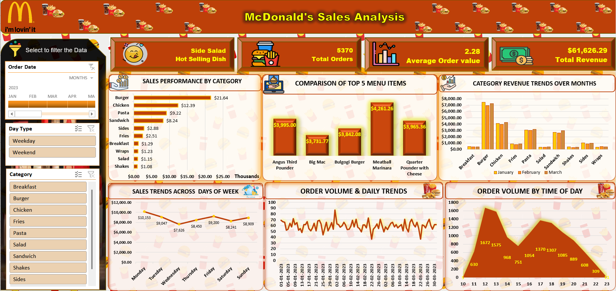


Slide 6
Key Findings for Sales Analysis 2023(Jan-Mar)
Total sales revenue during the period: $61,626.29
Top-performing category: Burger ($21,639.01 revenue)
Most popular item: Side Salad(631 orders)
Average items per order: 2.28
Peak order times: 12–2 PM and 5–7 PM
Top revenue generated item: Meatball Marinara
Strongest Sales on: Monday
Highest and Lowest revenue months:
Highest - March Lowest - February

Slide 7
Insights & Suggestions
Customer Spending Behaviour:
With an average of 2.28 items per order, it is likely that combo deals or bundled meals are already being utilized.
Suggestion:
I’m seeing an opportunity here so I would suggest to encourage meal upgrades or add-on purchases, particularly during peak hours.".
High Revenue Reliance on Burgers:
Burger category leads significantly in both revenue and volume.
Suggestion:
I would suggest to enhance the menu or introduce rotating seasonal burger offers as it may help sustain customer interest and reduce category fatigue.
Opportunity in Consistently Popular Items:
The Side Salad, while not high in unit price, leads in quantity.
Suggestions:
I would suggest Promoting it in value meals or driving add on sales with mains could increase overall AOV (Average Order Value).

Slide 8
Insights & Suggestions
Time-Based Promotions Potential:
Orders peak at lunch and evening snacks i.e. (12 PM–2 PM) and (5 PM–7 PM)
Suggestion:
I would suggest a focused promotions or loyalty rewards during slower hours (3–5 PM and post-8 PM) could help spread demand more evenly.
Weekday Business Dominance:
Weekdays drive significantly more volume.
Suggestion:
I would suggest to introduce some weekend-specific offers as it could boost off-peak sales and balance operational load.
Promotions or Seasonality?
higher revenue month across all categories may point to effective promotions or seasonal effects.
Suggestion:
I would suggest to analyze campaign effectiveness as it could guide future strategies for slower months.

Slide 9



Presented by: Shivani Awasthi
Mentored by: Ayushi Jain

